Slide 1
Natural Language Processing
Introduction
Dr. Muhammad Nouman Noor
Fall 2024

Slide 2
Welcome to NLP Course! (by ChatGPT!)
Welcome to the Natural Language Processing course!
NLP is an exciting and rapidly growing field that deals with the interaction between computers and human language.
In this course, you will learn about the techniques and algorithms used to analyze and understand human language, and you will have the opportunity to apply these techniques to real-world problems.
Whether you are a computer science student, a linguist, or just someone with an interest in language and technology, this course will provide you with a solid foundation in NLP and its applications.
Let's dive in and discover the amazing possibilities of NLP together!
2

Slide 3


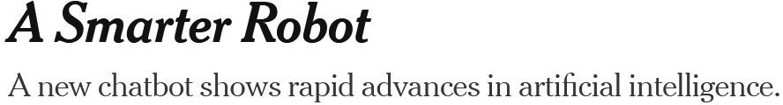





NLP is the KING!

Slide 4

Why this Course?!
So you have come here for information? I have some for you

Slide 5
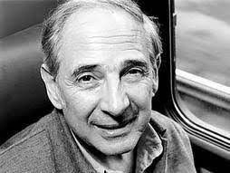
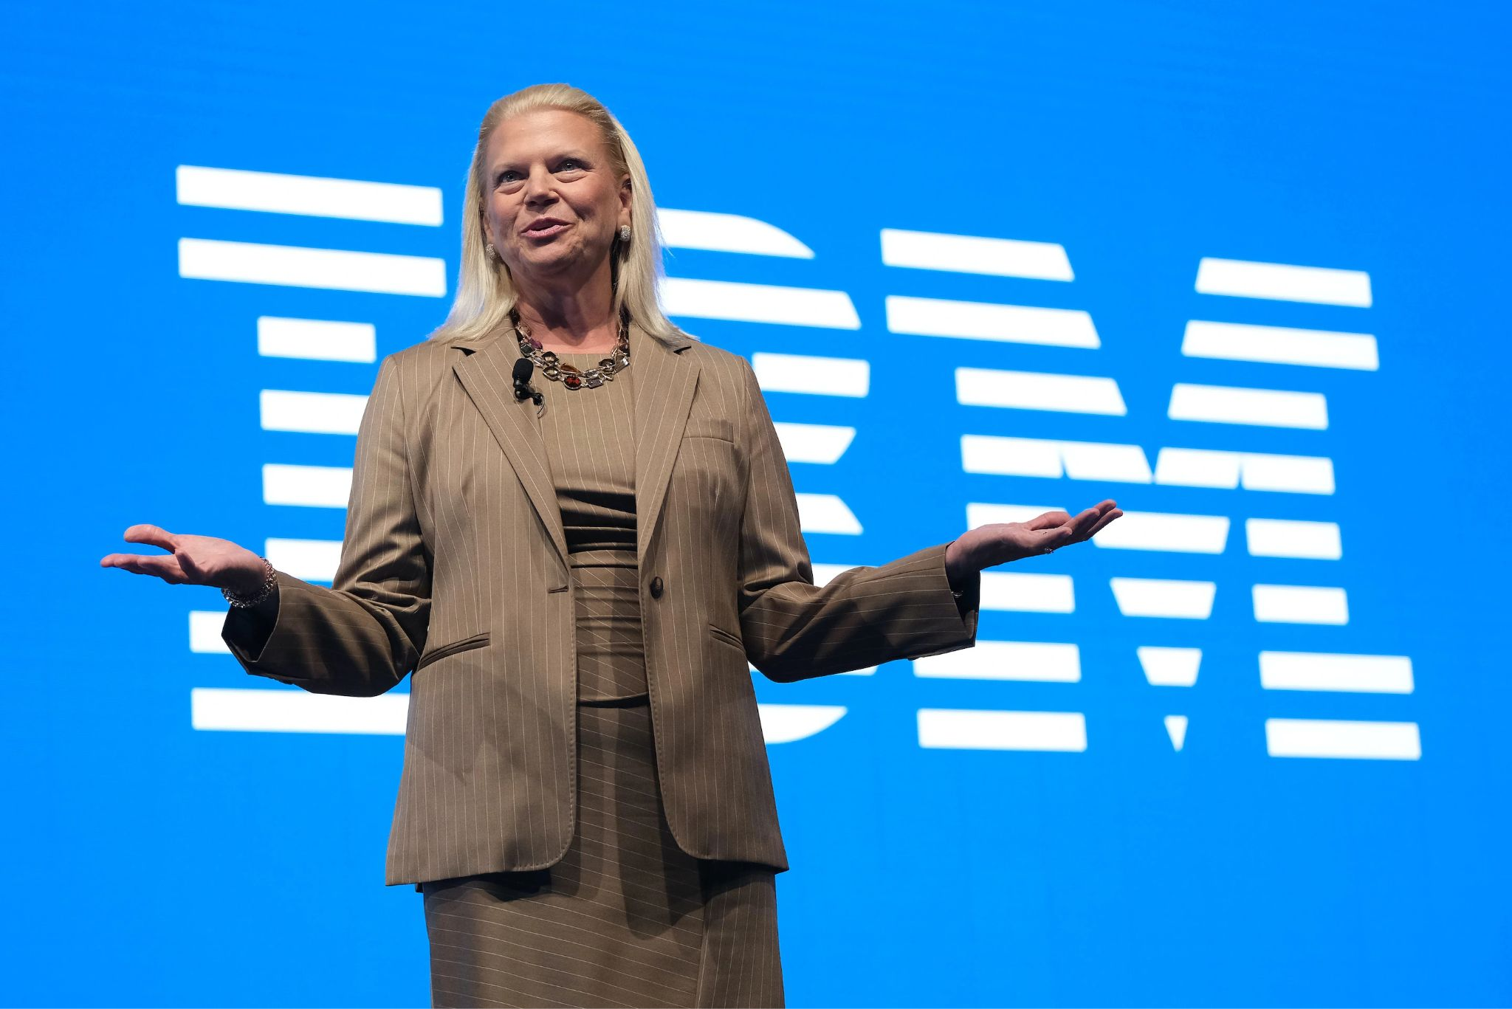

"Natural language is the most important part of artificial intelligence."
John Searle
"Natural language processing is a cornerstone of artificial intelligence, allowing computers to read and understand human language, as well as to produce and recognize speech."
Ginni Rometty
"Natural language processing is one of the most important fields in artificial intelligence and also one of the most difficult."
Dan Jurafsky

Slide 6
About the Course

Slide 7
Course Description
This course provides an introduction to the field of computational linguistics, aka natural language processing (NLP) providing a theoretical foundation and hands-on (lab-style) practice in computational approaches for processing natural language text. We will discuss problems involving different language system components (such as meaning in context and linguistic structures)
Students will collaborate in teams on modeling and implementing natural language processing and digital text solutions using Python and a variety of relevant tools
We will begin by discussing machine learning methods for NLP as well as core NLP, such as language modeling, part of speech tagging, and parsing. We will also discuss applications such as information extraction, machine translation, text generation, and automatic summarization

Slide 8
Course Learning Outcomes
Describe the fundamental concepts and techniques of natural language processing
Analyze the performance of a natural language processing system by applying the proper evaluation measures
Design and implement real applications using natural language processing systems
Analyze large volume text data generated from a range of real-world applications

Slide 9


Slide 10
What is Natural Language Processing (NLP)?

Slide 11

What is Natural Language Processing (NLP)?
Natural language processing is the set of methods for making human language accessible to computers
(Jacob Eisenstein)

Slide 12

What is Natural Language Processing (NLP)?
Natural language processing is the set of methods for making human language accessible to computers
(Jacob Eisenstein)
Natural language processing is the field at the intersection of Computer science (Artificial intelligence) and linguistics
(Christopher Manning)

Slide 13

What is Natural Language Processing (NLP)?
Natural language processing is the set of methods for making human language accessible to computers
(Jacob Eisenstein)
Natural language processing is the field at the intersection of Computer science (Artificial intelligence) and linguistics
(Christopher Manning)
Make computers to understand natural language to do certain task humans can do such as Machine translation, Summarization, Questions answering
(Behrooz Mansouri)

Slide 14

Example: Conversational Agent
Conversational agents contain:
Speech recognition
Language analysis
Dialogue processing
Information retrieval
Text to speech
Anees:
Open the pod bay doors, Hal.
HAL:
I’m sorry, Dave, I’m afraid I can’t do that.
Anees:
What are you talking about, Hal?
...HAL:
I know that you and Frank were planning to disconnect me, and I'm afraid that's something I cannot allow to happen.
2001: A Space Odyssey – HAL 9000
HAL is an artificial agent capable of such advanced language-processing behavior as speaking and understanding English, and at a crucial moment in the plot, even reading lips

Slide 15
Natural Language Processing: Terms
Natural language refers to the language that humans use to communicate with each other, such as English, Spanish, or Chinese
Processing
As distinguished from data processing
Question: How is data processing and natural language processing different?

Slide 16
Natural Language Processing: Terms
Consider the Unix wc program, which counts the total number of bytes, words, and lines in a text file
When used to count bytes and lines, wc is an ordinary data processing application
However, when it is used to count the words in a file, it requires knowledge about what it means to be a word and thus becomes a language processing system

Slide 17
Natural Language Processing vs Computational Linguistics
In linguistics, language is the object of study
Computational methods may be brought to bear, just as in scientific disciplines like computational biology and computational astronomy, but they play only a supporting role
In contrast, natural language processing is focused on the design and analysis of computational algorithms and representations for processing natural human language
The goal of natural language processing is to provide new computational capabilities around human language: for example, extracting information from texts, translating between languages, answering questions, holding a conversation, taking instructions

Slide 18
Knowledge Requirement for Machine
Machines require much broader and deeper knowledge of language
What does HAL need?

Slide 19
Knowledge Requirement for Machine
Machines require much broader and deeper knowledge of language
What does HAL need?
Recognize words from an audio signal and to generate an audio signal from a sequence of words
knowledge about phonetics and phonology: how words are pronounced in terms of sequences of sounds
HAL is capable of producing contractions like I’m and can’t
knowledge about morphology, the way words break down into component parts that carry meanings
HAL must use structural knowledge to properly string together the words that constitute its response
knowledge needed to order and group words comes under the heading of syntax
…

Slide 20
Knowledge Requirement for Machine
Phonetics and Phonology: knowledge about linguistic sounds
Morphology: knowledge of the meaningful components of words
Syntax: knowledge of the structural relationships between words
Semantics: knowledge of meaning
Pragmatics: knowledge of the relationship of meaning to the goals and intentions of the speaker
Discourse: knowledge about linguistic units larger than a single utterance

Slide 21
Phonetics and Phonology
Phonetics and Phonology: knowledge about linguistic sounds
The study of:
language sounds how they are physically formed;
systems of discrete sounds, e.g. languages’ syllable structure
dis-k&-'nekt disconnect

Slide 22

Morphology
Morphology: knowledge of the meaningful components of words
The study of the sub-word units of meaning
Even more necessary in languages:
Unsuccessfull → un success ful
(prefix) (stem) (suffix)

Slide 23
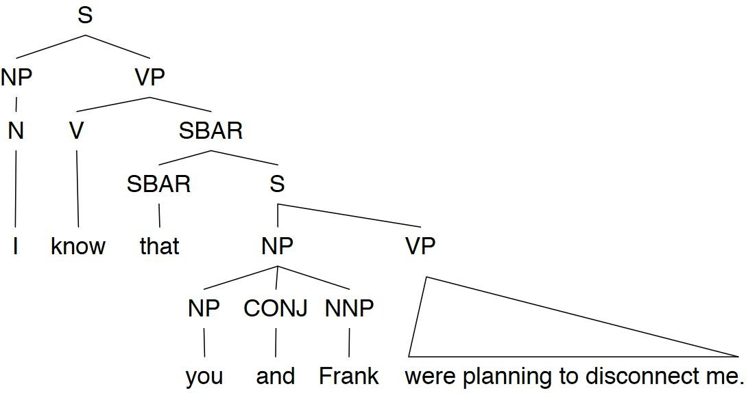
Syntax
Syntax: knowledge of the structural relationships between words
The study of the structural relationships between words
I know that you and Frank were planning to disconnect me.

Slide 24
Semantics
Semantics: knowledge of meaning
Word Sense Disambiguation
The study of the literal meaning
I know that you and Frank were planning to disconnect me.
ACTION = disconnect
ACTOR = you and Frank
OBJECT = me

Slide 25
Pragmatics
Pragmatics: knowledge of the relationship of meaning to the goals and intentions of the speaker
The study of how language is used to accomplish goals
What should you conclude from the fact I said something?
How should you react?
I’m sorry Dave, I’m afraid I can’t do that.
Includes notions of polite and indirect styles

Slide 26
Discourse
Discourse: knowledge about linguistic units larger than a single utterance
The study of linguistic units larger than a single utterance
The structure of conversations:
turn taking, thread of meaning

Slide 27
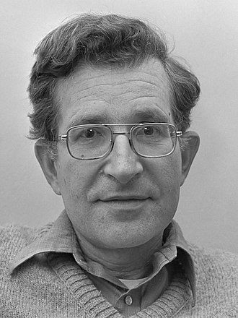
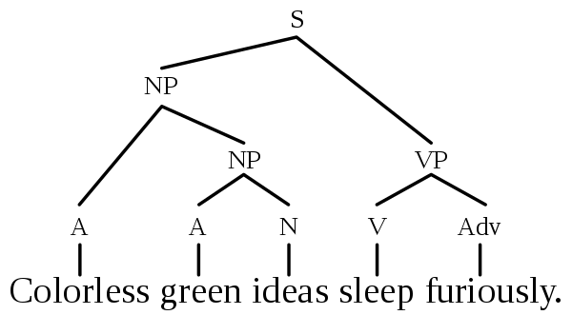
Syntax vs. Semantics
Colorless green ideas sleep furiously. (example by Noam Chomsky 1957)
Noam Chomsky
The most cited person alive

Slide 28



Semantics vs. Pragmatics
What does "You have a green light” mean?
 You are holding a green light bulb?
 You have a green light to cross the street?
 You can go ahead with your plan?

Slide 29
Is NLP hard?
What does this sentence mean? “I made her duck”
“duck”: noun or verb?
“make”: “cook X” or “cause X to do Y” ? “her”: “for her” or “belonging to her” ?

Slide 30
Is NLP hard?
What does this sentence mean? “I made her duck”
I cooked waterfowl for her
I cooked waterfowl belonging to her
I created the (plaster?) duck she owns
I caused her to quickly lower her head or body
I waved my magic wand and turned her into undifferentiated waterfowl
These different meanings are caused by a number of ambiguities

Slide 31
Is NLP hard?
What does this sentence mean? “I made her duck”
I cooked waterfowl for her
I cooked waterfowl belonging to her
I created the (plaster?) duck she owns
I caused her to quickly lower her head or body
I waved my magic wand and turned her into undifferentiated waterfowl
These different meanings are caused by a number of ambiguities
First, the words duck and her are morphologically or syntactically ambiguous in their part-of-speech
Duck can be a verb or a noun, while her can be a dative pronoun or a possessive pronoun
Second, the word make is semantically ambiguous; it can mean create or cook
Finally, the verb make is syntactically ambiguous in a different way

Slide 32

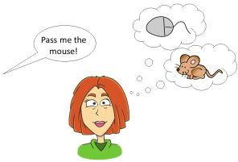
We Need to Disambiguate

Slide 33
Disambiguation
Models and algorithms in this course are ways to resolve or disambiguate these ambiguities
Deciding whether duck is a verb or a noun can be solved by part-of-speech tagging
Deciding whether make means “create” or “cook” can be solved by word sense disambiguation
Resolution of part-of-speech and word sense ambiguities are two important kinds of lexical disambiguation
A wide variety of tasks can be framed as lexical disambiguation problems
A text-to-speech synthesis system reading the word lead needs to decide whether it should be pronounced as in lead pipe or as in lead me on
Deciding whether her and duck are part of the same entity or are different entities is an example of syntactic disambiguation and can be addressed by probabilistic parsing

Slide 34
History of NLP

Slide 35
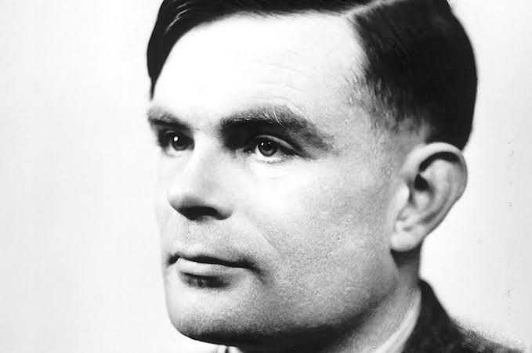
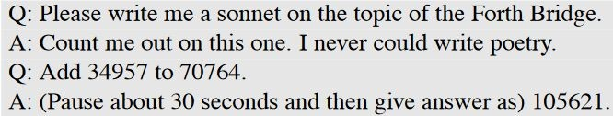
Turing Test
“Computing Machinery and Intelligence” Mind, Vol. 59, No. 236, pp. 433-460, 1950
I propose to consider the question "Can machines think?”...
We can only see a short distance ahead, but we can see plenty there that needs to be done
In Turing’s game, there are three participants: two people and a computer.
One of the people is a contestant who plays the role of an interrogator. To win, the interrogator must determine which of the other two participants is the machine by asking a series of questions via a teletype. The task of the machine is to fool the interrogator into believing it is a person by responding as a person would to the interrogator’s questions. The task of the second human participant is to convince the interrogator that the other participant is the machine and that she is human.

Slide 36
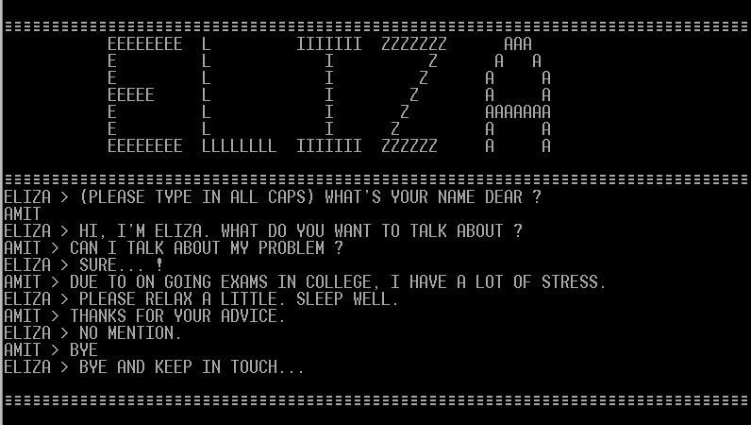
ELIZA
ELIZA was an early natural language processing system capable of carrying on a limited form of conversation with a user

Slide 37
1950 – 1970
Mid 1950’s – Mid 1960’s: Birth of NLP and Linguistics
At first, people thought NLP is easy! Researchers predicted that “machine translation” can be solved in 3 years or so
Mostly hand-coded rules / linguistic‐oriented approaches
The 3-year project continued for 10 years, but still no good result, despite the significant amount of expenditure
Mid 1960’s – Mid 1970’s: A Dark Era
After the initial hype, a dark era follows
People started believing that machine translation is impossible, and most abandoned research for NLP

Slide 38
1970 – 2000
1970’s and early 1980’s – Slow Revival of NLP
Some research activities revived, but the emphasis is still on linguistically oriented, working on small toy problems with weak empirical evaluation
Late 1980’s and 1990’s – Statistical Revolution!
By this time, the computing power increased substantially
Data-‐driven, statistical approaches with simple representation win over complex hand‐coded linguistic rules
“Whenever I fire a linguist, our machine translation performance improves.” (Jelinek, 1988)
2000’s – Statistics Powered by Linguistic Insights
With more sophistication with the statistical models, richer linguistic representation starts finding a new value

Slide 39
Recent Years
2010’s – Emergence of embedding model and deep neural networks
Several embedding models for text using neural networks and deep neural networks were proposed including Word2Vec, Glove, fastText, Elmo, BERT, COLBERT, GTP[1-3.5]
New techniques brought attention to more complex tasks

Slide 40
Tasks/Applications in NLP

Slide 41
A few of the NLP Tasks
Spell Checking, Keyword Search, Finding Synonyms
Part of Speech Tagging
Extracting information from a website
Location, people, temporal expressions
Classifying text
Sentiment analysis
Machine translation
Complex question answering
Spoken dialog systems

Slide 42
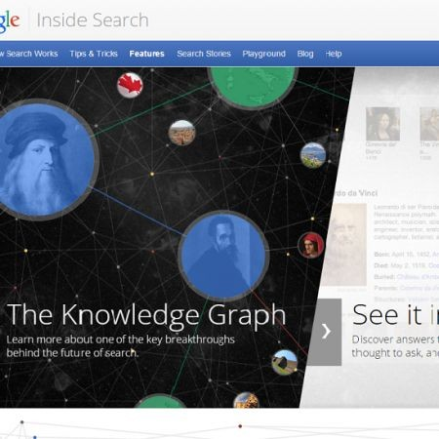
Knowledge & Information Extraction
Knowledge graphs (KGs) organize data from multiple sources, capture information about entities of interest in a given domain or task (like people, places or events), and forge connections between them
The Google Knowledge Graph is an enormous database of information that enables Google to provide immediate, factual answers to your questions

Slide 43
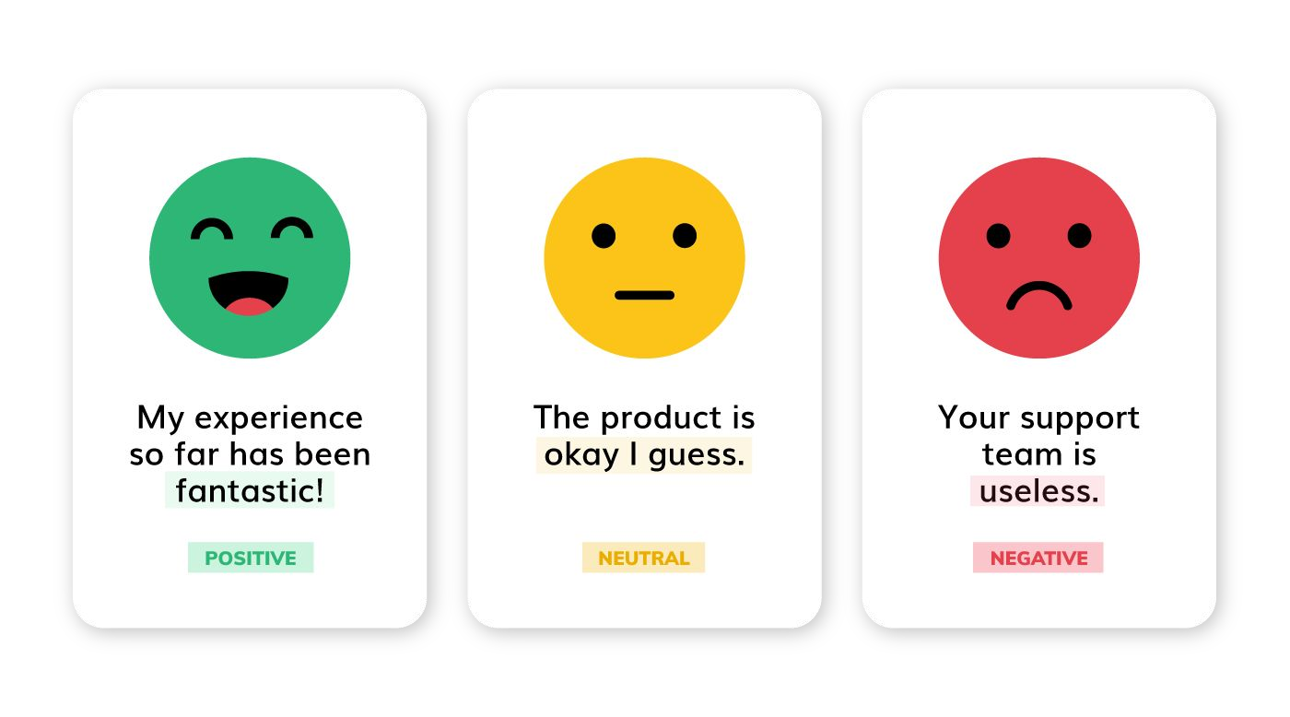
Sentiment Analysis
Determine whether the meaning behind data is positive, negative, or neutral

Slide 44
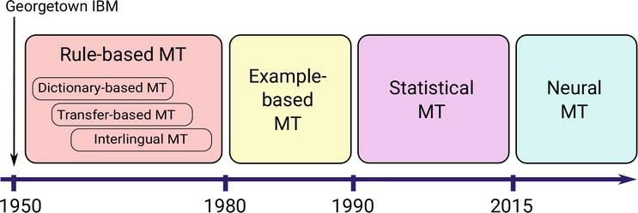

Machine Translation
6,800 living languages 600 with written tradition
100 spoken by 95% of population
Low resource languages can be challenging?

Slide 45
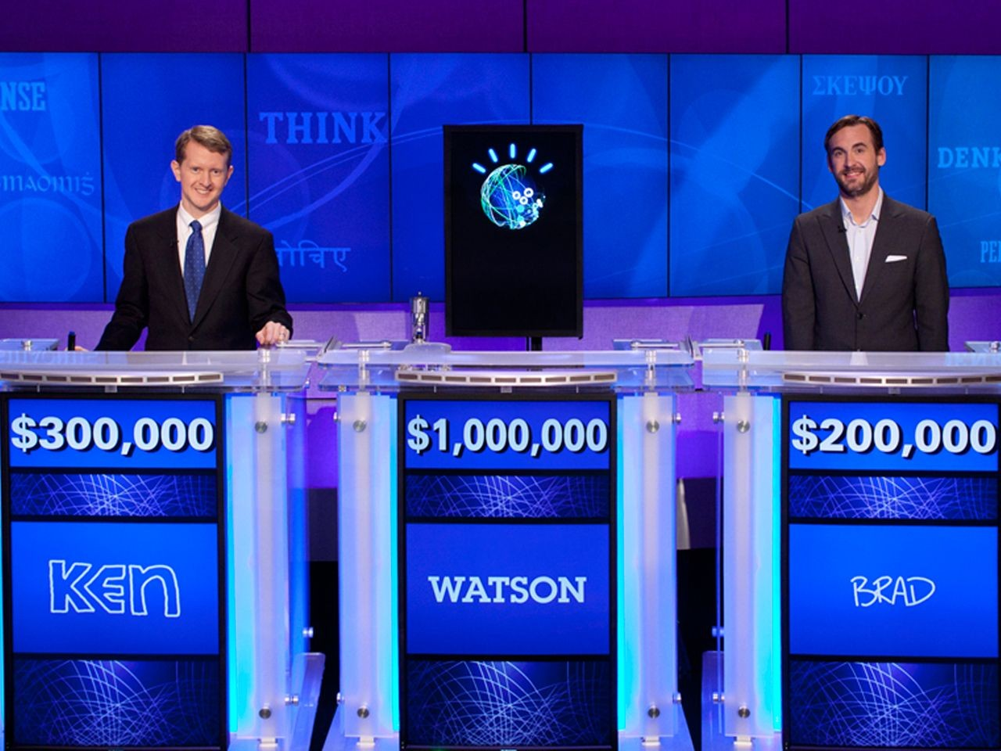
Question Answering
IBM-Watson Defeats Humans in "Jeopardy!"

Slide 46
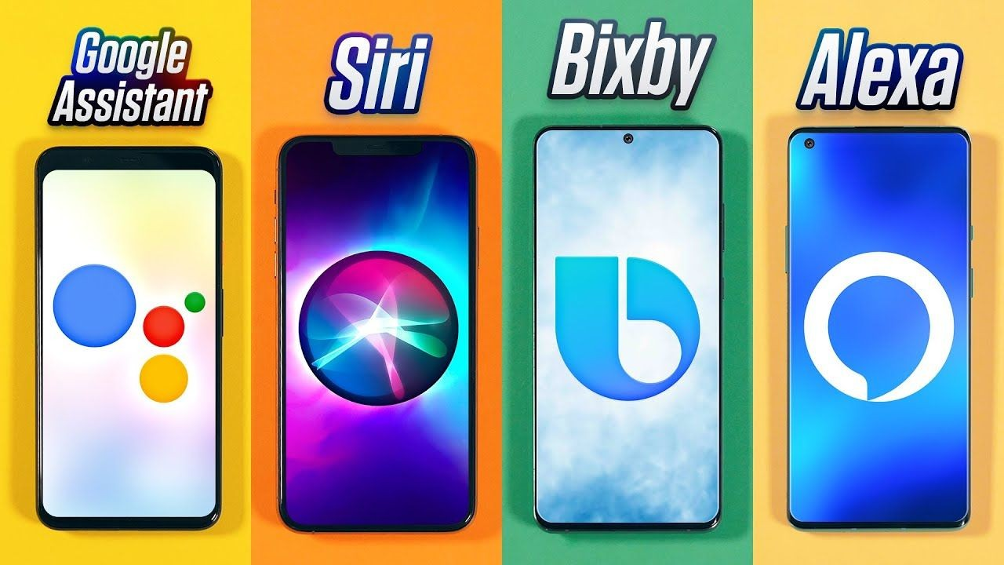
Spoken Dialog Systems

Slide 47
Where to find Tasks and Test Collections?
EMNLP: Conference on Empirical Methods in Natural Language Processing https://2022.emnlp.org/
ACL: Association for Computational Linguistics https://2023.aclweb.org/
NAACL: Annual Conference of the North American Chapter of the Association for Computational Linguistics https://2022.naacl.org/
CoNLL: Conference on Computational Natural Language Learning https://conll.org/2022 COLING: International Conference on Computational Linguistics https://coling2022.org/
CLEF: Conference and Labs of the Evaluation Forum https://clef2022.clef-initiative.eu/index.php SemEval: Workshop on Semantic Evaluation https://semeval.github.io/SemEval2023/tasks.html

Slide 48

Summary
Today we learned about:

Slide 49

Summary
In previous session we learned about:
What is Natural Language Processing
What makes Natural Language Processing hard Natural Language Processing Tasks

Slide 50
Next Session

Slide 51
Python Refresher
You will be reminded of python programming
We will review:
Basic programming concepts in Python
https://docs.python.org/3/tutorial/
Using libraries, including those needed for this course
To do:
You should also review the Getting Started page of Google Colab Notebooks
Bring laptop for testing
Reading: Chapter 1 of Jurafsky Book (here)
Question: How can we crawl data from the internet?
Note: You may use other IDEs and editors
55

